Slide 1
Basics of
Machine Learning
Dmitry Ryabokon, github.com/dryabokon

Slide 2

Lesson 10
Parametrical ML methods

Slide 3
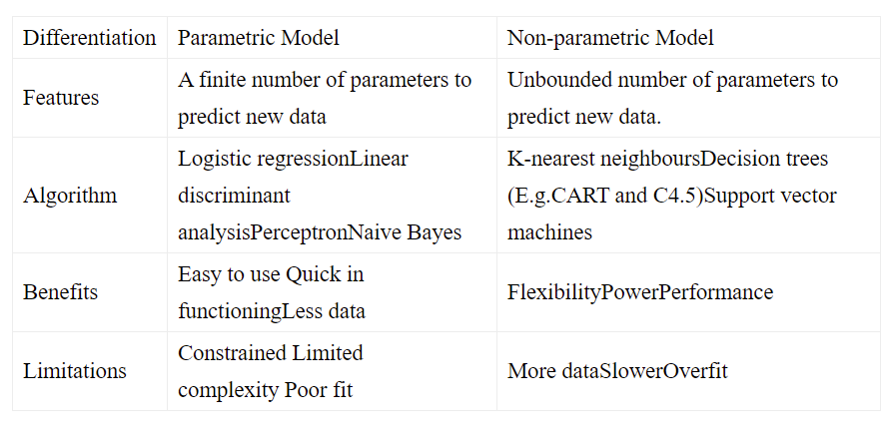
Supervised Learning
Summary
Naive Bayesian classifier
Gaussian classifier

Slide 4
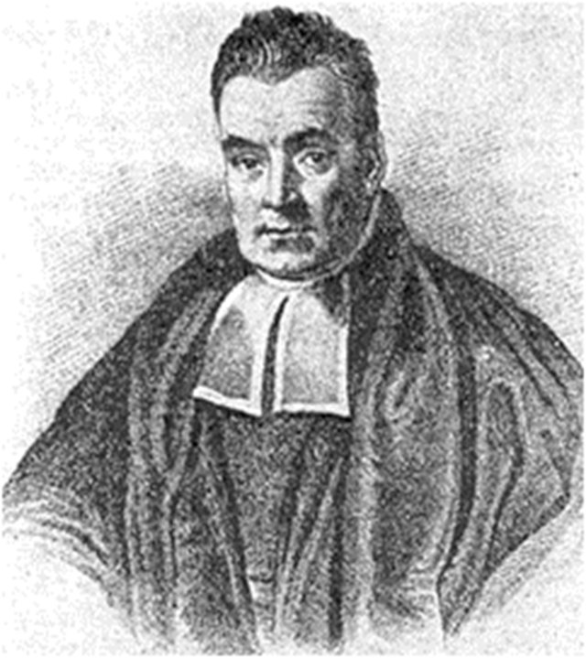
Naive Bayesian
classifier

Slide 5
Naive Bayesian classifier
Advantages
Very simple, easy to implement and fast.
If the NB conditional independence assumption holds, then it will converge quicker than discriminative models like logistic regression.
Even if the NB assumption doesn’t hold, it works great in practice.
Need less training data.
Highly scalable. It scales linearly with the number of predictors and data points.
Can be used for both binary and multi-class classification problems.
Can make probabilistic predictions.
Handles continuous and discrete data.
Not sensitive to irrelevant features.

Slide 6
Naive Bayesian classifier
The problem
feature
few states are possible
decision strategy

Slide 7
Naive Bayesian classifier
Example
1/6
3/9
4/6
3/9
1/6
3/9
1/6
4/6
1/6
4/9
2/9
3/9

Slide 8
Naive Bayesian classifier
Example
1/6
3/9
4/6
3/9
1/6
3/9
1/6
4/6
1/6
4/9
2/9
3/9

Slide 9
Gaussian classifier

Slide 10
Gaussian classifier
Definitions
feature

Slide 11
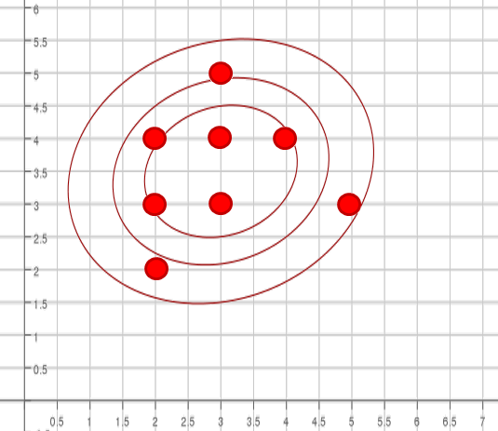
Gaussian classifier
Example
5
4
3
2
2
3
4
5

Slide 12
Gaussian classifier
5
4
3
2
2
3
4
5

Slide 13
Gaussian classifier
Decision strategy

Slide 14
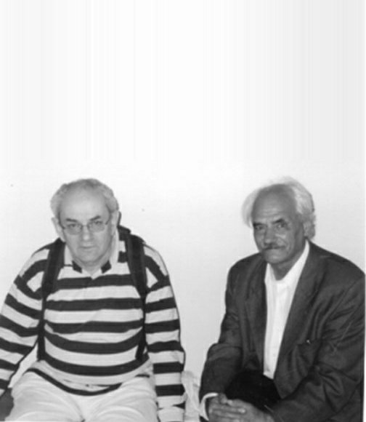
Linear discrimination
Vapnik
Chervonenkis

Slide 15
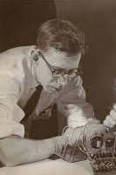
Linear discrimination
Rosenblatt
Perceptron
input
output

Slide 16
Linear discrimination
Perceptron
output

Slide 17
Linear discrimination
Perceptron
=

Slide 18
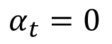
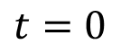
Linear discrimination
Perceptron: tuning
$$t=0$$
$$α_{t}=0$$
while (sets are not separated by hyperplane)

Slide 19
Linear discrimination
Perceptron: tuning

Slide 20
Linear discrimination
Perceptron: tuning

Slide 21
Linear discrimination
Perceptron: tuning

Slide 22
Linear discrimination
Perceptron: tuning

Slide 23
Linear discrimination
Perceptron: tuning

Slide 24
Linear discrimination
Perceptron: tuning

Slide 25
Linear discrimination
Perceptron: tuning

Slide 26
Linear discrimination
Perceptron: tuning

Slide 27
Linear discrimination
Perceptron: convergence

Slide 28
Linear discrimination
Transformation of the feature space
a line in R
2

Slide 29
Linear discrimination
Transformation of the feature space
5
hyperplane in R
2
elliptic curve in R

Slide 30
Linear discrimination
SVM: support vector machine
Separate by the widest band

Slide 31
Linear discrimination
SVM: support vector machine
penalty
ξ
ξ
Separate by the widest band

